Slide 2
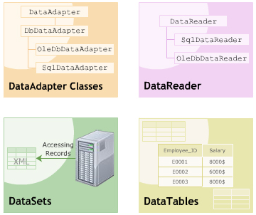
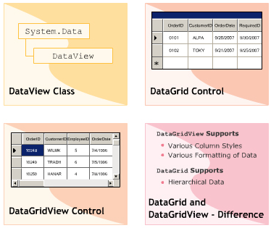
Objectives
Data Classes:
DataAdapter
DataReader
DataSet
DataTable
DataView
DataGridView Control

Slide 3
DataAdapter
Consists of a set of SQL commands and a DB Connection:
These are used to fill the DataSet & update the data source
ADO.NET implements various data adapters inherited from the DbDataAdapter class:
SqlDataAdapter
OleDbDataAdapter
Properties | AcceptChangesDuringFill, AcceptChangesDuringUpdate, FillLoadOption, TableMappings
Methods | Fill, Update, GetFillParameters
Event | FillError

Slide 4
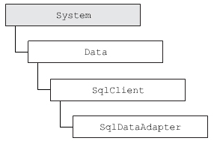
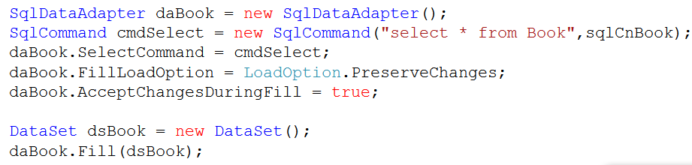
SqlDataAdapter
Serves as a link betweena DataSet and the SQL Server Database for retrieving and saving data.
Property | SelectCommand, InsertCommand,UpdateCommand DeleteCommand
Event | RowUpdated, RowUpdating

Slide 5
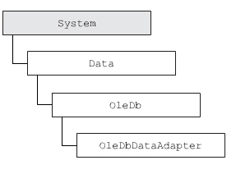
OleDbDataAdapter
Used to connect to multiple database such as : SQLServer, Access, Oracle
Exists in the namespace : System.Data.OleDb
Have the same properties and events as SqlDataAdapter

Slide 6
SqlDataReader
Used to read data from SQL Server in a sequential manner:
Retrieves a forward-only and read-only stream of data
Is used in the connected architecture of ADO.NET
Steps for retrieving data:
Connect to SQL Server by SqlConnection
Invoke ExecuteReader() method of SqlCommand object
Read the records by Read() method
Property | FieldCount, HasRows, IsClosed,RecordsAffected
Method | Read, GetByte, GetChar, GetInt32, GetSqlString, GetString, GetValue, GetName, Close

Slide 7
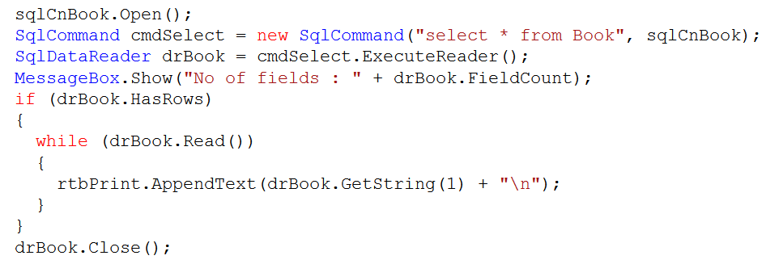
Notes:
Phương thức Open để trước thực thi ExecuteReader()

Slide 8
DataSet
Is a representation of database objects in cached memory.
Includes relational tables and constraints.
Interacts with data source indirectly.
Features:
Working with disconnected data
Working with Hierarchical data
Caching changes
Supporting XML
Implementing Uniform functionality
Property | DataSetName, Relations, Tables, Locale
Method | AcceptChanges, Clear, Merge, GetXml, ReadXml, WriteXML, RejectChanges,
Notes:
Property:
Locale: information used to compare strings in a table
Method:
GetXml: get the XML representation of the stored data
ReadXml: read XML schema + data → dataset

Slide 9
More on DataSets …
Types of DataSet :
TypeDataSet :
Have a schema xsd
UntypeDataSet :
Create by a code : DataSet A = new DataSet()
Fetching XML data using DataSets:
ReadXML(string path) : read XML file to DataSet
WriteXML(string path) : save the content DataSet to a XML file
Navigate Record :
Using the index of the collection (table)
Using BindingSource class and methods such as :
MoveFirst, MoveLast, MoveNext, MovePrevious

Slide 10
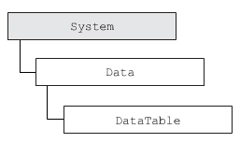
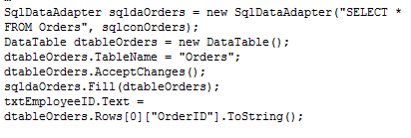
DataTable
Represent a table in DataSet
Have a constraint objects that ensure data integrity.
Property | TableName, Columns, Rows, DataSet, ParentRelations, ChildRelations
Method | Clear,Load, AcceptChanges, NewRow, ReadXml, WriteXml, Select
Event | ColumnChanged, RowChanged, RowDeleted, TableNewRow
Notes:
Một DataTable chỉ chứ 1 bảng match từ DataSource
Một DataSet chứa nhiều DataTable
Quan hệ thực thể (entity relationships): 1-1, 1- nhiều (nhiều -1), nhiều – nhiều
Ràng buộc bảng : 1 -1 ; 1 –nhiều
Master Details : Quan hệ 1 là master, quan hệ nhiều là details
Quan hệ bảng:

Slide 11
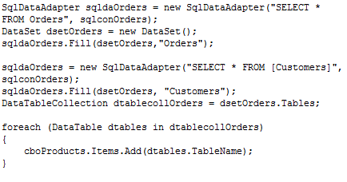
DataTableCollection
is a collection of the DataTables in DataSet
Property | Count, Item
Method | Clear,Add, Remove
Event | CollectionChanged

Slide 12
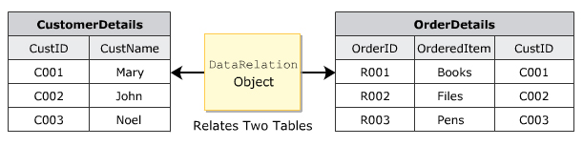
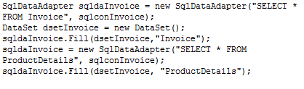

DataRelation
Maintains referential integrity by enforcing :
Foreign-key constraint
Unique constraint
Cascade update and delete operation
Use to relate two columns that exist in two tables.

Slide 13
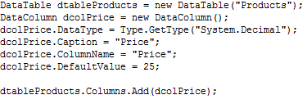
DataColumn class
Used for creating a schema for a particular column
Can be added to a DataColumnCollection
Properties:
Caption,ColumnName,DataType, DefaultValue, MaxLength, Table, Unique

Slide 14
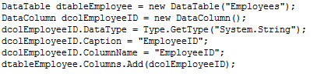

DataRow
Represent a row in a DataTable
Property | Item, RowError, RowState, Table
Method | AcceptChanges, Delete, SetAdded

Slide 15
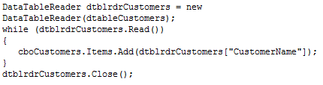
DataTableReader
Is used to retrieve data from one or more DataTables in forward-only and read-only mode.
Is a new class introduced in .NET Framework 2.0.
Allows to iterate rows in the cache memory
DataTableReader dtr = dataTable.CreateDataReader()
Property | GetData, GetDataTypeName, GetName, GetString, GetValue, FieldCount, IsClosed, Item
Method | Close, NextResult, Read

Slide 16
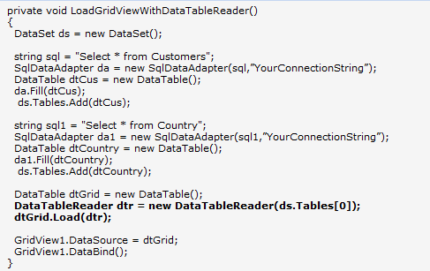

Demo

Slide 17
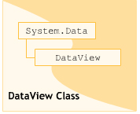
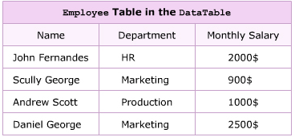
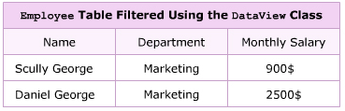
DataView
Used to sort , filter , search, modify and navigate through the records
Constructor of this class is a DataTable
Property | AllowDelete,AllowEdit, AllowNew, Count, Item, RowFilter, RowStateFilter, Sort, Table
Method | Addnew, Close, Delete, Dispose, Find, Open, ToTable
Event | Initialized, ListChanged

Slide 18
DataViewManager
Used to specify the settings for each table in the dataset.
Is useful for binding a DataSet to more than one table and display them in the DataView.
Ensures that accurate and required data is retrieved from each table.
Property | DataSet, DataViewSettings
Method | CreateDataView
Event | ListChanged

Slide 19
DataGrid control
Display data in a tabular format
Populated by the table present in dataSet ( binding)
Insert , delete , update → DataSet
Property | CurrentCell, CurrentRowIndex, DataBindings, DataMember, DataSource, Item
Method | BeginEdit, Collapse, IsExpanded, IsSelected, NavigateBack, NavigateTo, Select, Unselect

Slide 20
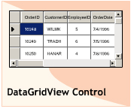
DataGridView control
Provides different column styles such as text,check …
Supports multiple data sources with different databases.
Allows to use the cache memory → enhances performance
Uses the BindingSource to simplify the process of data binding.
Property | AutoGenerateColumns, Columns, DataMember, DataSource, Item, Rows, SelectedColumns, SelectedRows
Method | ClearSelection, CommitEdit, DisplayedColumnCount, DisplayedRowCount, GetCellCount, SelectAll,Sort
Event | AutoGenerateColumnsChanged, CellClick, CellValueChanged, DataMemberChanged, DataSourceChanged, RowValidated, RowValidating

Slide 21
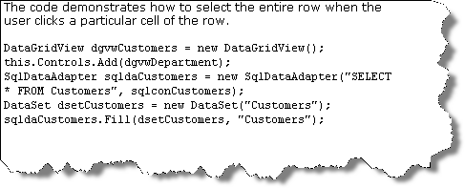
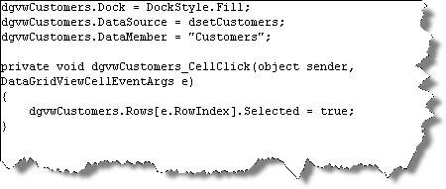
Example

Slide 22
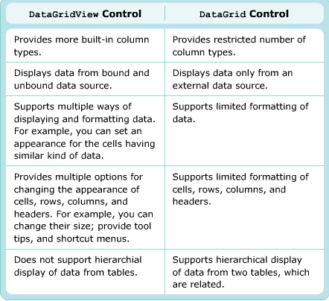
DataGridView & DataGrid control

Slide 23
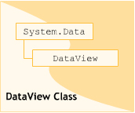
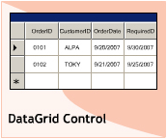
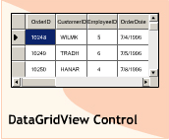
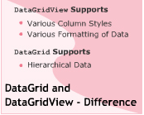
Summary

